Slide 1
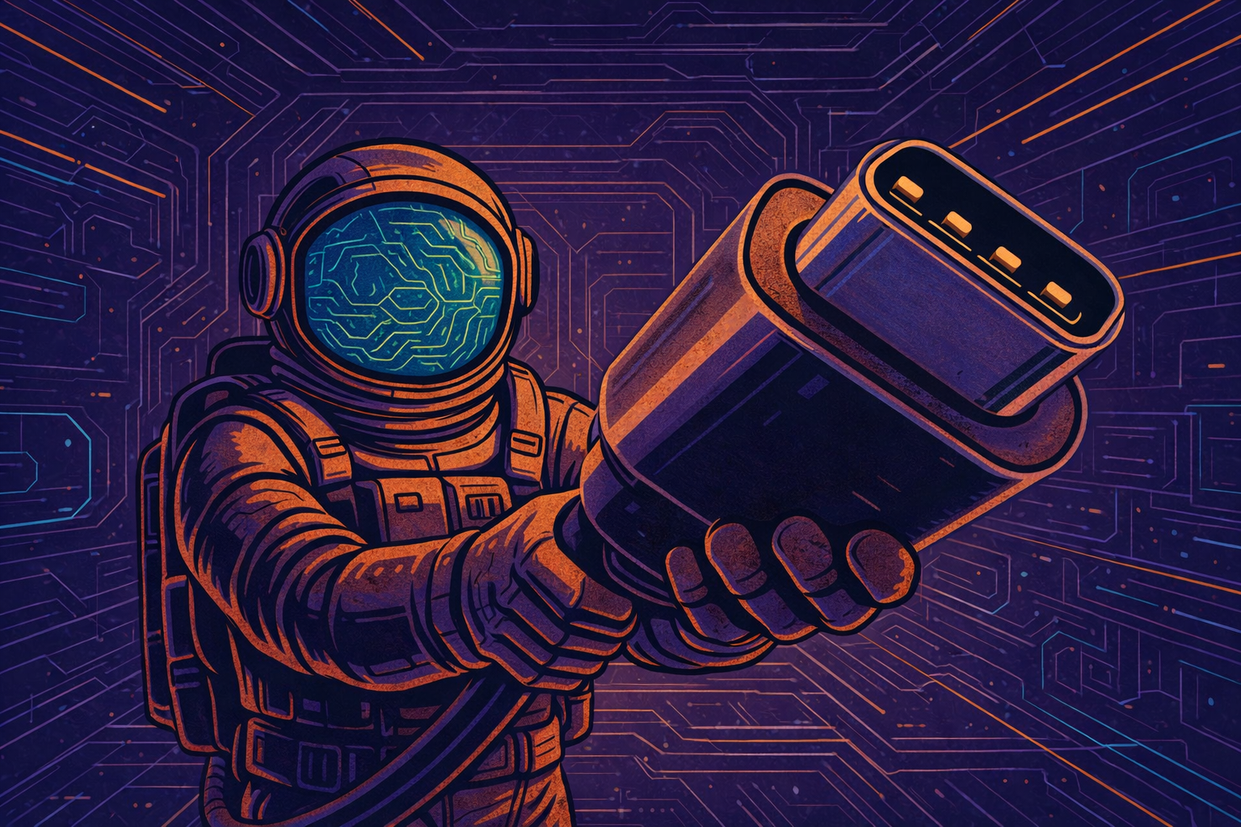
What is MCP?
Model
Context
Protocol
from Anthropic
“The usb-c port for AI applications”
“an open-source standard for connecting AI applications to external systems”

Slide 2
In practice:
Easy way to use Tools written by someone else
Easy way to share your Tools with others
Easy way to connect LLMs with Tools
The game-changer is the adoption & ecosystem
It’s the interface, not the tools themselves
It’s an agreed standard, not major innovation
Still might be ‘passing fad’ - there are new evolving ways to integrate LLMs with Tools like Skills

Slide 3
Technicality 1
3 pieces of the puzzle
MCP Host
Like,
Claude
Claude Code
OpenAI Agents SDK
MCP Client
MCP Server
MCP Client
MCP Server
MCP Client
MCP Server

Slide 4
Technicality 2
3 transport mechanisms
stdio - MCP server runs on your computer
sse - a legacy approach now deprecated
Streamable HTTP - the updated version
MCP Host
MCP Client
MCP Server
MCP Client
MCP Server
MCP Client
MCP Server

